Slide 1
Web Programming V – C# ASP.NET MVC

Slide 2
Hands-on MVC
Other slide packs cover MVC theory
Prior to this, make sure you grasp a bit of the theory
Hands-on
Create MVC project from scratch
BYO
Views
Controllers
Models
Understand how MVC is implemented, the Microsoft way
Folders
Scafolding/helpers
Notes:
Based on http://www.tutorialsteacher.com/mvc/create-first-asp.net-mvc-application

Slide 3
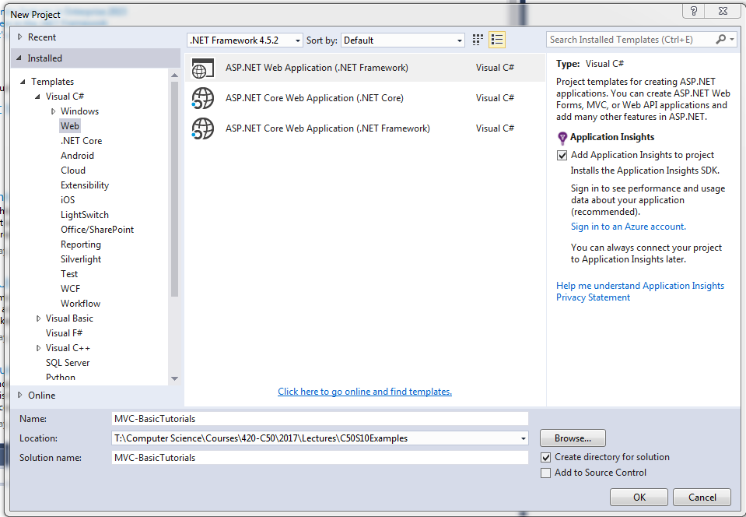
Creating the project
Notes:
Segway – this follows the evolution of Web pages (next slide)

Slide 4
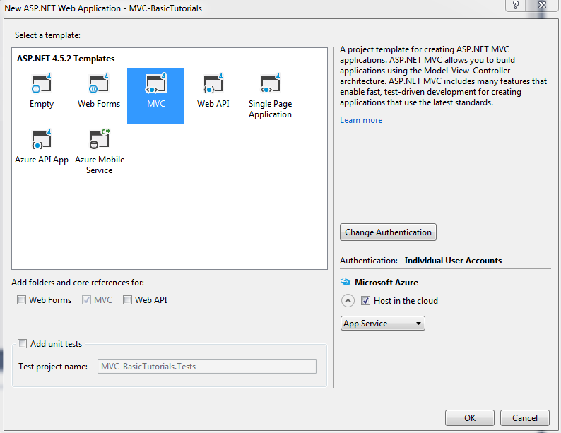
Creating the project
Notes:
Project gets setup with default folders

Slide 5
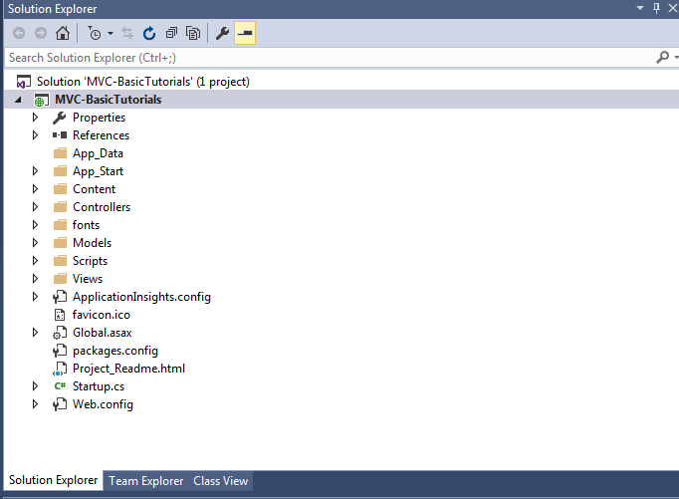
The Empty Project
Notes:
Project gets setup with default folders
Walk thru the folders

Slide 6
Things to Try
Build the project
Navigate around
Go to the Home page
Go to About
Go to Contact
Notice anything about the URL?
Examine the code
What is the relationship between the URL and the code?
This is URL routing, a URL routes to a controller/method
Notes:
URL is site/Controller/Action

Slide 7
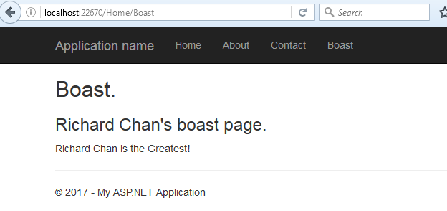
Things to Try
Make our own action within the Home page
Create a “Boast” page as an option off of the Home view
Things to note:
ViewBag is just a container shared between the Controller and View to pass info
@Razor syntax (we’ll learn of this later)
Did you remember to put a link into the top nav bar? (If not, you can manual navigate to it)
Notes:
Create Boast View in Views/Home
Put something boastful in there
3) Add an action in the home controller to pull it up
4) Note convention between action and view name (automatic)
5) To update the Nav bar, note that every view references Views/Shared/_Layout.cshtml (update this for the Nav bar). Add Boast to this

Slide 8
You’ve just learnt
How to make new actions within a controller
How to make a new view for that new action
Tweaked the HTML, seen where the HTML comes from for each view

Slide 9
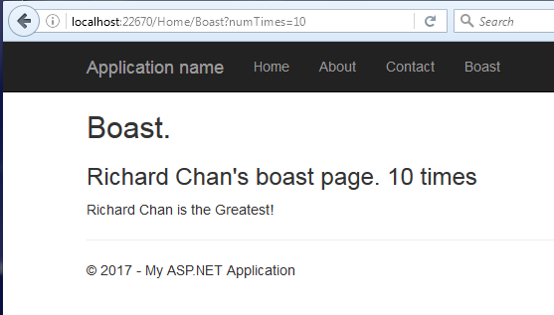
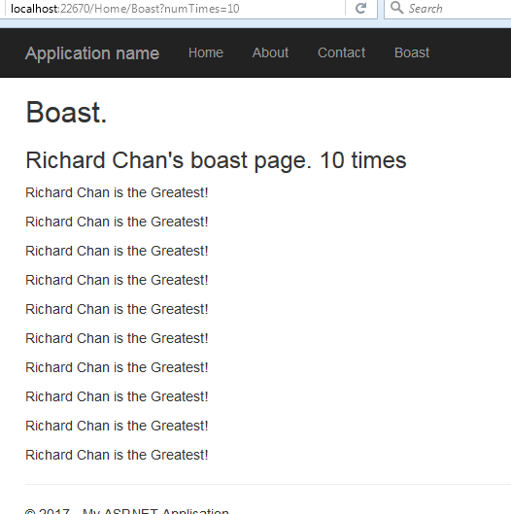
More on URL routing – passing parameters
Change your Boast action to take an optional parameter, listing how many times it will boast
Steps
Just echo back the parameter
Make it loop in the view
Add numTimes in the ViewBag to pass it into the view from the controller
Write Razor code to use the numTimes passed in
@for (int i = 0; i < ViewBag.numTimes; i++)
{
<p>Richard Chan is the Greatest!</p>
}
Notes:
Show App_Start/RouteConfig.cs to show that the URL routing can be customized

Slide 10
You’ve just learnt
How to parameterize the actions/URL
How to use the ViewBag to pass parameters between the Controller and the View
A bit of Razor code to dynamically create HTML in your view.
Note: any client side code can go into the view page as well
The @ syntax just does the server side execution for the page.
This is how MVC gives you more transparency on how the client-side code is rendered over WebForms.
Notes:
Note that your project by default include BootStrap and jQuery (see Content and Scripts folders)

Slide 11
Things to Try (now that you’ve mastered controllers and views)
Create a model and build a controller and view for it
Things to note:
ViewBag is just a container shared between the Controller and View to pass info
@Razor syntax (we’ll learn of this later)
Did you remember to put a link into the top nav bar? (If not, you can manual navigate to it)
Notes:
Note that your project by default include BootStrap and jQuery (see Content and Scripts folders)

Slide 12
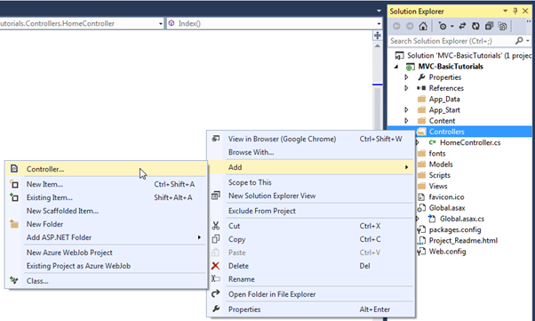
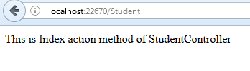
Creating a new Controller
Create a Controller caller StudentController
Things to note:
Select MVC5 Controller – Empty
The StudentController is derived from the Controller class
The View folder is created for you (Views/Student)
Update the StudentContoller.Index() to:
public string Index()
{
return "This is Index action method of StudentController";
// return View();
}
Build and navigate to the StudentController
Notes:
Note that your project by default include BootStrap and jQuery (see Content and Scripts folders)

Slide 13
Creating a new Model
On Model folder
Add->NewItem->C# code->Class
Create a class called Student
Add attributes, gets/sets
We will use this model with a controller and view
Example: Model class
namespace MVC_BasicTutorials.Models
{
public class Student
{
public int StudentId { get; set; }
public string StudentName { get; set; }
public int Age { get; set; }
}
}
Notes:
Make sure it builds
http://www.tutorialsteacher.com/mvc/mvc-model

Slide 14
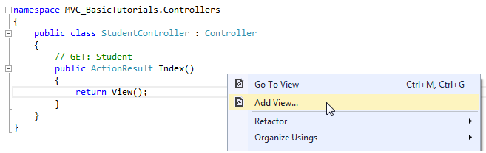
Creating a new View
We will create a view, which will be rendered from Index method of StudentContoller. So, open a StudentController class -> right click inside Index method -> click Add View..
Scaffolding template->List
Model class:Student
Layout ~/Views/Shared/_Layout.cshtml
Notes:
http://www.tutorialsteacher.com/mvc/mvc-view
Note: a new view in the View/Student folder
Can’t run it yet, the controller doesn’t pass the model to the view yet.

Slide 15
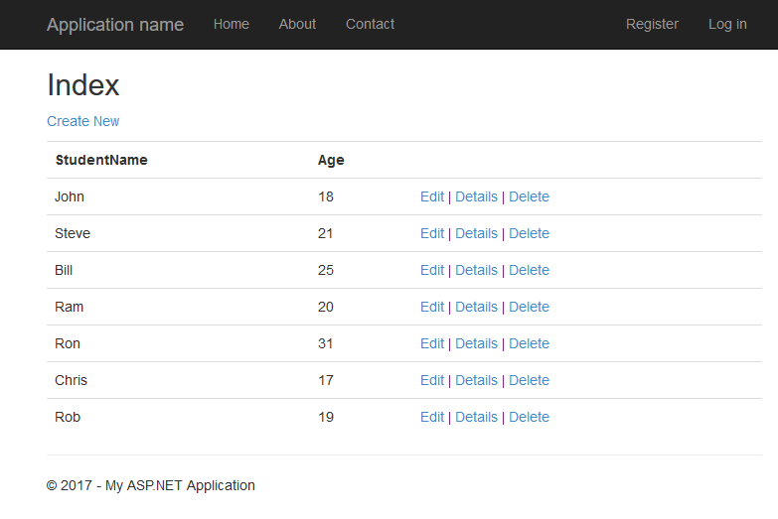
Let’s update the model to contain data and be accessible from the controller
Pull in Student.cs from the sample file provided
It creates a dummy list of Students for you
It is referenced by the StudentController.Index()
Notes:
http://www.tutorialsteacher.com/mvc/mvc-view
Explain the Singleton concept
url /Student sample shown
Demonstrate that it’s just HTML (view source) built by C# Razor code (compare to Student View
What happens if you click on “Create New”? It fails, no such method.
To fix this:
Add the Create action to the Student Controller
Some way to update the StudentList.
For now, create a dummy for the Create, and Edit and just echo back what’s being requested
Stretch goal: add mutators to the StudentList class and call it from the StudentController.
Things to try:
Style the Student list page
Add the Student list page to the Nav bar at top
Create dummies for the CRUD
Replace the dummy with real code

Slide 16
Hints on manipulating the StudentList
List functions
Max() – find the max Id currently in use for adding and generating a new, unused Id
Where() – find item from list
Add() – add item to list
Remove() – remove item from list

